Slide 1
Variables, Data Types, and Arithmetic Expressions
Course Code: CSC1102 &1103
Course Title: Introduction to Programming
Dept. of Computer Science
Faculty of Science and Technology
Lecturer No: | 2 | Week No: | 1 (1X1.5 hrs) | Semester:
Lecturer: | Md. Mazid-Ul-Haque, Email: mazid@aiub.edu

Slide 2
Lecture 2: Outline
Variables, Data Types, and Arithmetic Expressions
Working with Variables
Understanding Data Types and Constants
The Basic Integer Type int
The Floating Number Type float
The Extended Precision Type double
The Single Character Type char
The Boolean Data Type _Bool
Storage sizes and ranges
Type Specifiers: long, long long, short, unsigned, and signed
Working with Arithmetic Expressions
Integer Arithmetic and the Unary Minus Operator
The Modulus Operator
Integer and Floating-Point Conversions
Combining Operations with Assignment: The Assignment Operators
Types _Complex and _Imaginary

Slide 3
Variables
Programs can use symbolic names for storing computation data
Variable: a symbolic name for a memory location
programmer doesn’t have to worry about specifying (or even knowing) the value of the location’s address
Variables have to be declared before they are used
Variable declaration: [symbolic name(identifier), type]
Declarations that reserve storage are called definitions
The definition reserves memory space for the variable, but doesn’t put any value there
Values get into the memory location of the variable by initialization or assignement

Slide 4
Variables - Examples
int a; // declaring a variable of type int
int sum, a1,a2; // declaring 3 variables
int x=7; // declaring and initializing a variable
a=5; // assigning to variable a the value 5
a1=a; // assigning to variable a1 the value of a
L-value
a1=a1+1; // assigning to variable a1 the value of a1+1
// (increasing value of a1 with 1)
R-value

Slide 5
Variable declarations
Data type Variable name
Which data types
are possible
Which variable names
are allowed

Slide 6
Variable names
Rules for valid variable names (identifiers) in C :
Name must begin with a letter or underscore ( _ ) and can be followed by any combination of letters, underscores, or digits.
Any name that has special significance to the C compiler (reserved words) cannot be used as a variable name.
Examples of valid variable names: Sum, pieceFlag, I, J5x7, Number_of_moves, _sysflag
Examples of invalid variable names: sum$value, 3Spencer, int.
C is case-sensitive: sum, Sum, and SUM each refer to a different variable !
Variable names can be as long as you want, although only the first 63 (or 31) characters might be significant. (Anyway, it’s not practical to use variable names that are too long)
Choice of meaningful variable names can increase the readability of a program

Slide 7
Data types
Basic data types in C: int, float, double, char, and _Bool.
Data type int: can be used to store integer numbers (values with no decimal places)
Data type type float: can be used for storing floating-point numbers (values containing decimal places).
Data type double: the same as type float, only with roughly twice the precision.
Data type char: can be used to store a single character, such as the letter a, the digit character 6, or a semicolon.
Data type _Bool: can be used to store just the values 0 or 1 (used for indicating a true/false situation). This type has been added by the C99 standard (was not in ANSI C)

Slide 8
Data types
Data Type | Size | Range | Description
int | 4 bytes | -2,147,483,648 to 2,147,483,647 | Stores whole numbers, without decimals
float | 4 bytes |  | Stores fractional numbers, containing one or more decimals. Sufficient for storing 7 decimal digits
double | 8 bytes |  | Stores fractional numbers, containing one or more decimals. Sufficient for storing 15 decimal digits
boolean | 1 byte | true or false | Stores true or false values
char | 1 bytes | 0 to 255 | Stores a single character/letter/number, or ASCII values

Slide 9
Assigning values to char
char letter; /* declare variable letter of type char */
letter = ‘A'; /* OK */
letter = A; /* NO! Compiler thinks A is a variable */
letter = “A"; /* NO! Compiler thinks “A" is a string */ letter = 65; /* ok because characters are really
stored as numeric values (ASCII code),
but poor style */

Slide 10
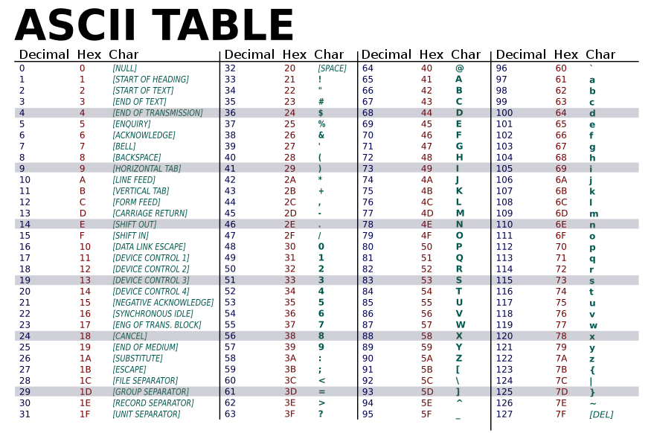

Slide 11
Storage sizes and ranges
Every type has a range of values associated with it.
This range is determined by the amount of storage that is allocated to store a value belonging to that type of data.
In general, that amount of storage is not defined in the language. It typically depends on the computer you’re running, and is, therefore, called implementation- or machine-dependent.
For example, an integer might take up 32 bits on your computer, or it might be stored in 64.You should never write programs that make any assumptions about the size of your data types !
The language standards only guarantees that a minimum amount of storage will be set aside for each basic data type.
For example, it’s guaranteed that an integer value will be stored in a minimum of 32 bits of storage, which is the size of a “word” on many computers.

Slide 12
Working with arithmetic expressions
Basic arithmetic operators: +, -, *, /
Precedence: one operator can have a higher priority, or precedence, over another operator.
Example: * has a higher precedence than +
a + b * c
if necessary, you can always use parentheses in an expression to force the terms to be evaluated in any desired order.
Associativity: Expressions containing operators of the same precedence are evaluated either from left to right or from right to left, depending on the operator. This is known as the associative property of an operator
Example: + has a left to right associativity
In C++ there are many more operators -> later in this course !

Slide 14
Working with arithmetic expressions
#include <iostream>
using namespace std;
int main (void)
{
int a = 100;int b = 2;
int c = 25;int d = 4;
int result;
result = a - b; // subtraction
cout<<"a - b = “<< result<<endl;
result = b * c; // multiplication
cout<<"b * c = “<< result<<endl;;
result = a / c; // division
cout<<"a / c = “<< result<<endl;
result = a + b * c; // precedence
cout<<"a + b * c = “<<result<<endl;
return 0;
}

Slide 15
Precedence of Operators
Precedence
!, ++, --, (type)
*, /, %
+, -
=

Slide 16
Integer and Floating-Point Conversions
Assign an integer value to a floating variable: does not cause any change in the value of the number; the value is simply converted by the system and stored in the floating
Assign a floating-point value to an integer variable: the decimal portion of the number gets truncated.
Integer arithmetic (division):
int divided to int => result is integer division
int divided to float or float divided to int => result is real division (floating-point)

Slide 17
The Type Cast Operator
f2 = (float) i2 / 100; // type cast operator
The type cast operator has the effect of converting the value of the variable i2 to type float for purposes of evaluation of the expression.
This operator does NOT permanently affect the value of the variable i2;
The type cast operator has a higher precedence than all the arithmetic operators except the unary minus and unary plus.
Examples of the use of the type cast operator:
(int) 29.55 + (int) 21.99 results in 29 + 21
(float) 6 / (float) 4 results in 1.5
(float) 6 / 4 results in 1.5

Slide 18
The assignment operators
The C++ language permits you to join the arithmetic operators with the assignment operator using the following general format: op=, where op is an arithmetic operator, including +, –, ×, /, and %.
op can also be a logical later in this course
Example:
count += 10;
Equivalent with:
count=count+10;
Example: precedence of op=:
a /= b + c
Equivalent with:
a = a / (b + c)
addition is performed first because the addition operator has higher precedence than the assignment operator

Slide 19
Declaring variables
Some older languages (FORTRAN, BASIC) allow you to use variables without declaring them.
Other languages (C, Pascal) impose to declare variables
Advantages of languages with variable declarations:
Putting all the variables in one place makes it easier for a reader to understand the program
Thinking about which variables to declare encourages the programmer to do some planning before writing a program ( What information does the program need? What must the program to produce as output? What is the best way to represent the data?)
The obligation to declare all variables helps prevent bugs of misspelled variable names.
Compiler knows the amount of statically allocated memory needed
Compiler can verify that operations done on a variable are allowed by its type (strongly typed languages)

Slide 20
Declaration vs Definition
Variable declaration: [Type, Identifier]
Variable definition: a declaration which does also reserve storage space (memory) !
Not all declarations are definitions
In the examples seen so far, all declarations are as well definitions
Declarations which are not definitions: later in this semester !

Slide 21
Executing a program
Statement1
Statement2
Statement3
Statement4
Statement5
Statement6
Statement7
Statement8
Program = list of statements
Entrypoint: the point where the execution starts
Control flow: the order in which the individual statements are executed
Notes:
I think this slide should be at the beginning of the course. Not inside loop.

Slide 22
Structure of a C++ program
Entry point of a C++ program
int main ()
{
int value1, value2, sum;
value1 = 50;
value2 = 25;
sum = value1 + value2;
cout<<"The sum = “ <<sum<<endl;
return 0;
}
Sequential
flow of control
Notes:
This is to remind sequential flow and how we can repeat it using loop.

Slide 23
Controlling the program flow
Forms of controlling the program flow:
Executing a sequence of statements
Repeating a sequence of statements (until some condition is met) (looping)
Using a test to decide between alternative sequences (branching)
Statement1
Statement2
Statement3
Statement4
Statement5
Statement6
Statement7
Statement8
Notes:
Can be simplified after discarding the previous two slides.

